Slide 1
Applied Linear Regression on The Insurance Dataset
Eric Wu, Allison Schaedler, Xinyi Bao, Derek Avery

Slide 2
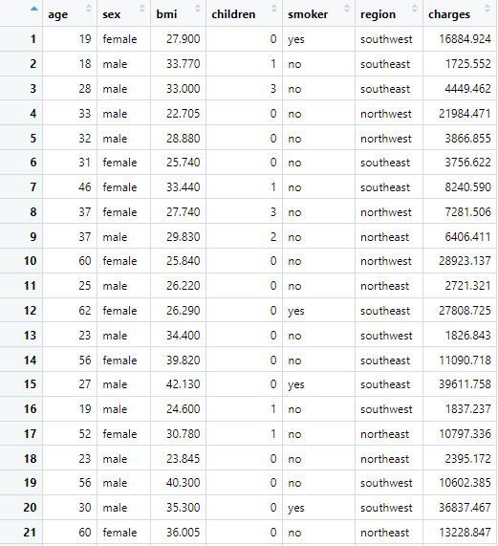
Background - Insurance Dataset
Kaggle.com, the Medical costs for over 1300 individuals based on age, sex, BMI in the United Stated
Data Dimension: 1338 Observations and 7 variables
Reference: https://www.kaggle.com/datasets/joebeachcapital/medical-insurance-costs/data
Notes:
Before getting into the research question, here is the background for our dataset that we chose.
The Insurance dataset extracted from Kaggle.com describes the medical costs for over 1300 individuals based on their age, sex, BMI in the United States.
D

Slide 3

Research Question
Goal: examine how the number of children, Smoker or not, and the regions in the U.S they lived influence the medical costs
Method: multiple linear regression and LASSO regression.
Notes:
The goal of the project is to examine how the number of children, Smoker or not, and the regions in the U.S they lived influence the medical costs.
The methods of the project are using multiple linear regression to find the best model with the lowest MSE value and use LASSO regression to make the comparison. In addition, there will be a detail diagnostic on the linear regression model for the assumptions, outliers, and other possible issues.
X

Slide 4
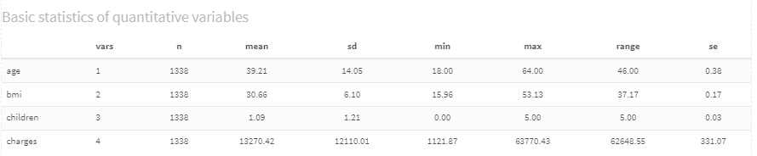
Basic Statistics of the Data
Notes:
A

Slide 5
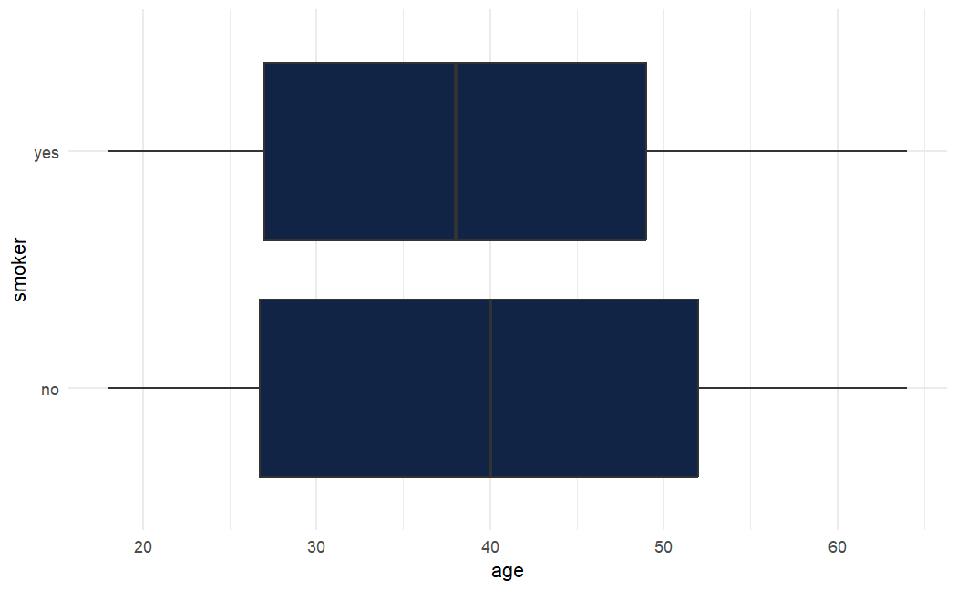
Data Visualization: Smoker and Age
These boxplots show the relationship between the variables age and smoker.
The average age of smokers is slightly lower than the average age of non-smokers.
There are no outliers visible on the plot.
The strata are reasonably homogenous.
Notes:
A

Slide 6
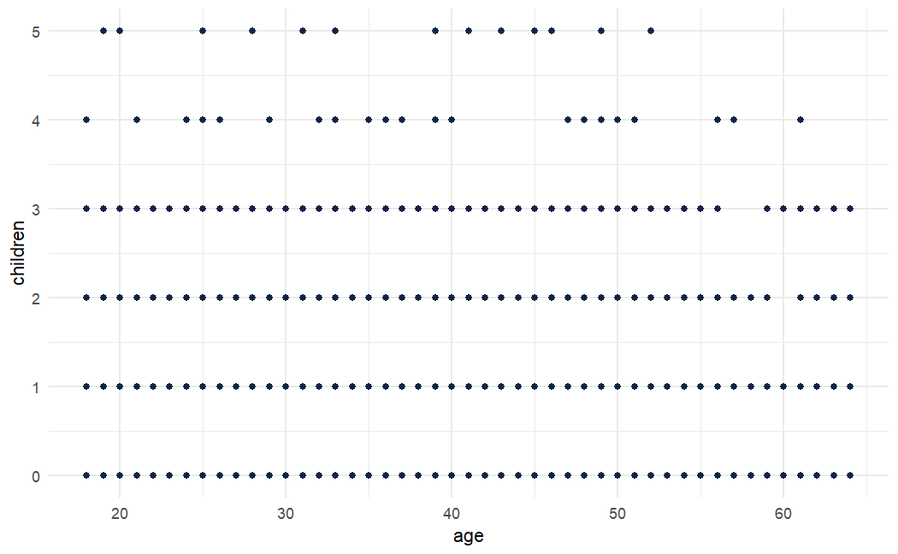
Data Visualization: Age and Number of Children
This plot shows the relationship between age and number of children.
Most of the data is concentrated between 0 to 3 children across the whole spectrum of ages.
There is no obvious pattern in the data.
There is no obvious correlation between the variables based on this plot.
Notes:
A

Slide 7
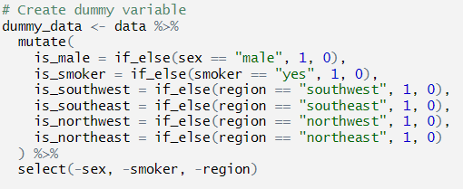
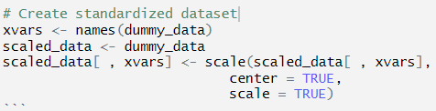
Data Transformation
Notes:
E

Slide 8
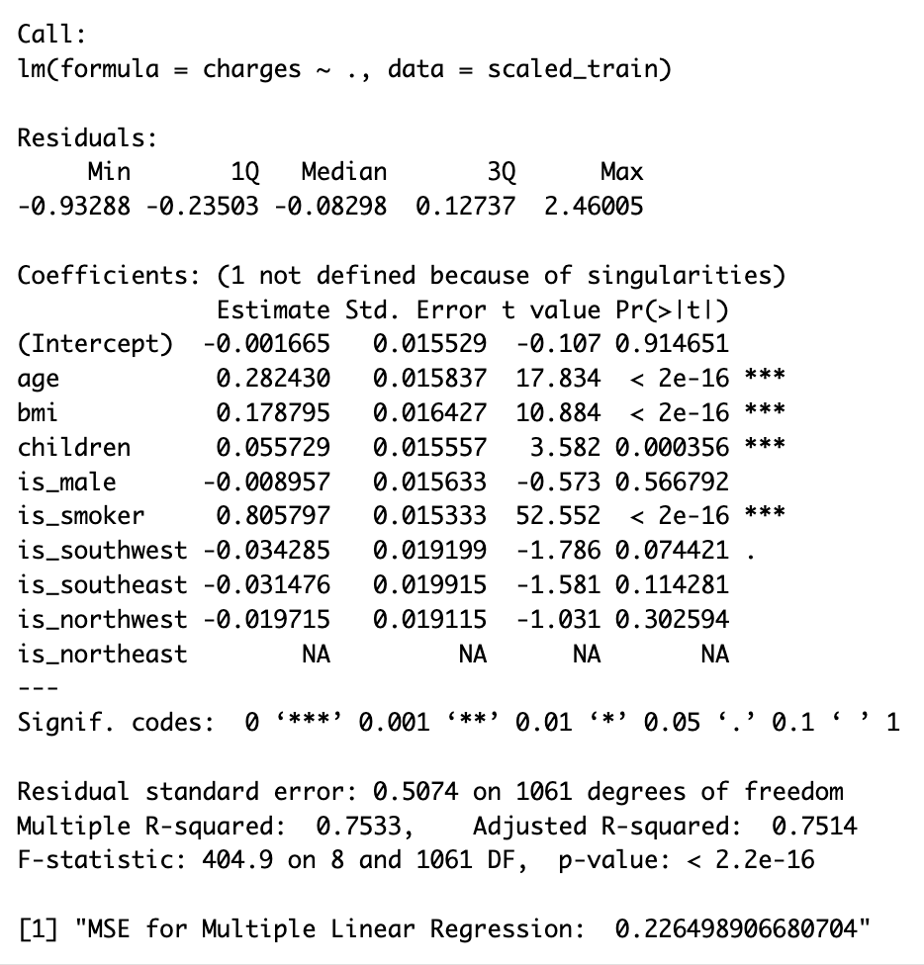
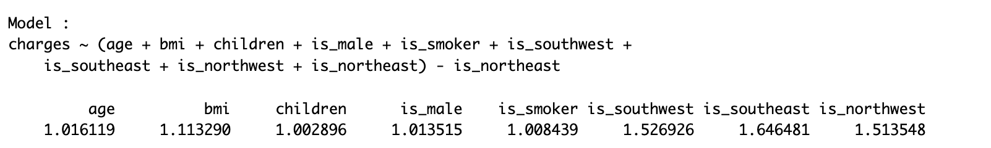
Multiple Linear Regression
R-squared = 0.7533
Adjusted R-squared = 0.7514
F-statistic is highly significant (p < 2.2e-16)
age, bmi, children, and is_smoker are significant predictors of charges, with p-values less than 0.05.
They has the positive coefficient with charges.
MSE = 0.2265
VIF
Notes:
The model explains a significant amount of variance in the charges, with an R-squared value of 0.7533. This indicates that approximately 75.33% of the variability in charges can be explained by the model.
The Adjusted R-squared value is 0.7514, which adjusts for the number of predictors in the model and suggests that the model fits the data well.
The F-statistic is highly significant (p < 2.2e-16), indicating that the model as a whole is statistically significant.
Coefficients:
age, bmi, children, and is_smoker are significant predictors of charges, with p-values less than 0.05.
age, bmi, children has the positive coefficient with charges. When age, bmi, and number of children is increasing, the cost of the medical insurance will also increase.
is_smoker has the largest coefficient of 0.8058, which means being a smoker is associated with a substantial increase in charges.
is_southwest has a p-value close to the significance level, which may warrant further investigation.
The is_northeast variable is not defined due to singularities, likely due to it being perfectly collinear with the other region variables. This is often handled by omitting one category of a categorical variable to serve as a baseline.
Other Analysis:
Key variables like age and smoking status are strong predictors of charges.
The Mean Squared Error (MSE) for the model is 0.2265, which is relatively low and indicates good predictive performance.
X

Slide 9
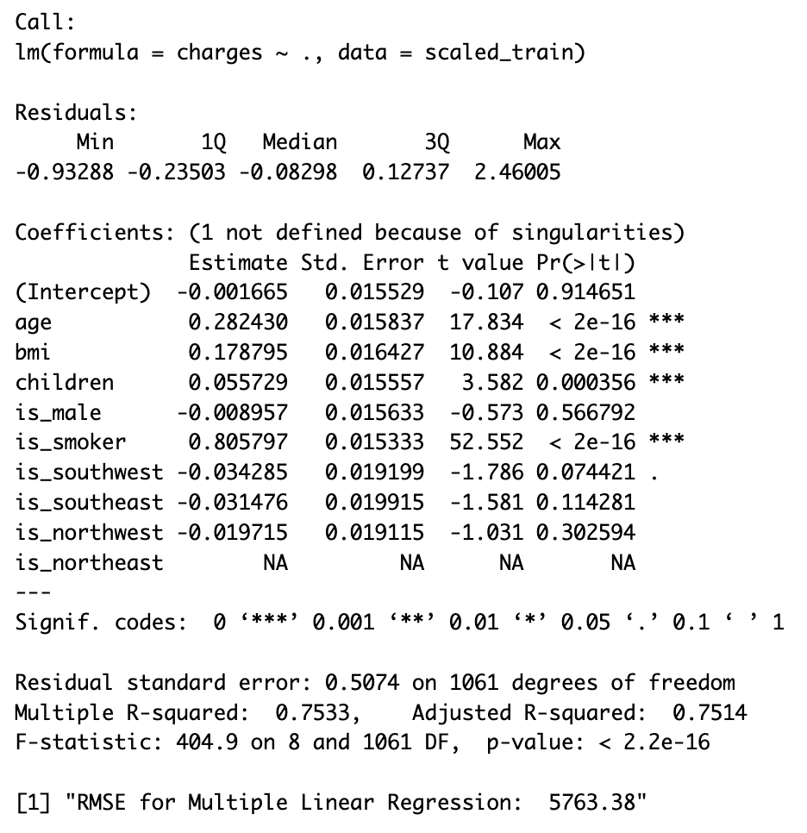
Multiple Linear Regression
RMSE = 5763.38
Notes:
With the actual data, we get the RMSE, which is 5763.38
X

Slide 10
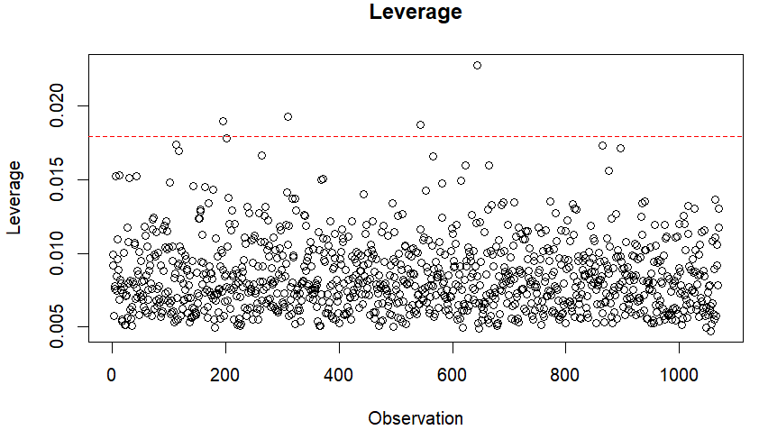
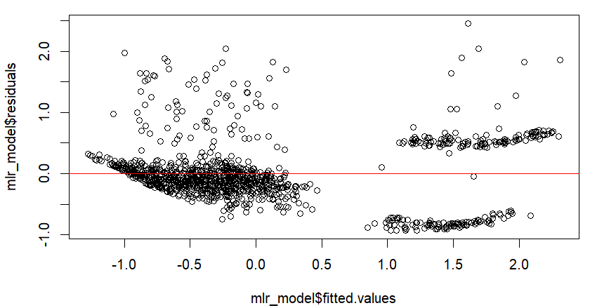
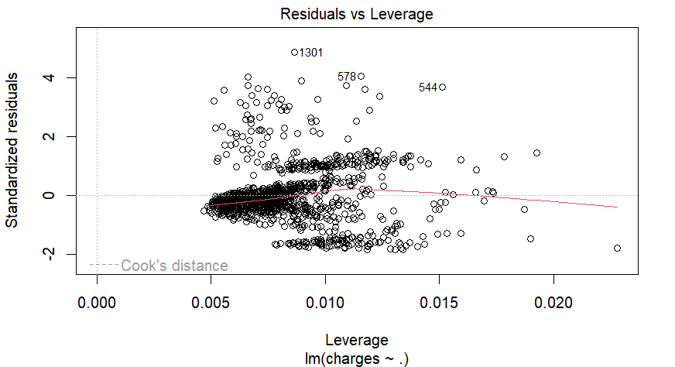
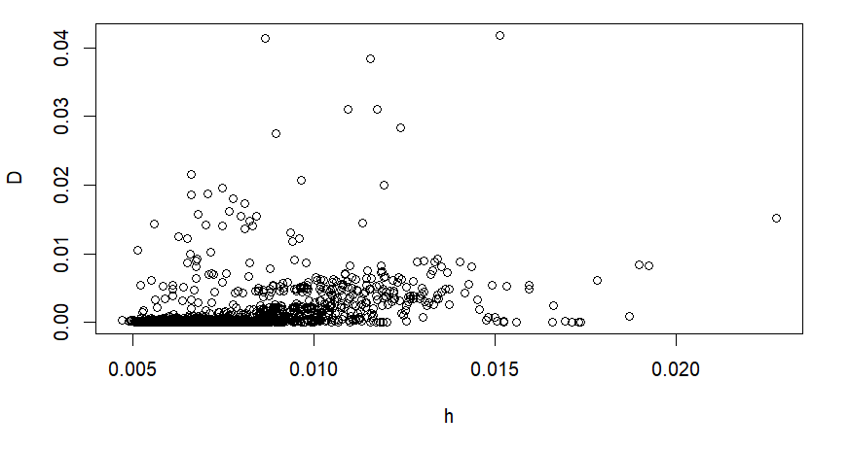
LINE Assumption
Notes:
D
The basic assumptions for a linear regression are: Linearity, Independence, Normality, and Equivariance. If any of these assumptions are violated, there are two concerns: incorrect conclusions and interpretations, or a lack of power for discovery.
By analyzing the residuals vs fitted values plot, it can be determined that there is relative equivariance between data points, given the line of best fit going through all these points has a slope of zero.
By doing a test to see if we have any points with large leverage, we received results that indicate some points have large leverage in the model that may need to be investigated.
Based on the results for the Cook's distance tests, there appears to be no data points that have a Cook's Distance greater than 1. Therefore, there are no outliers in the dataset.

Slide 11
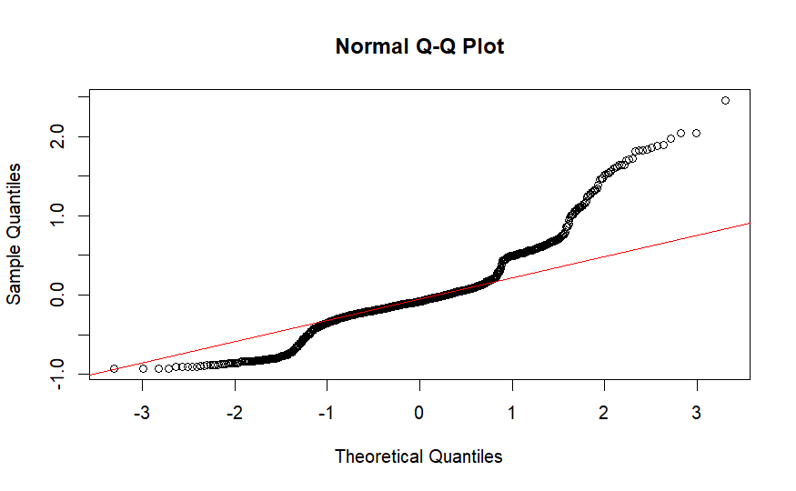
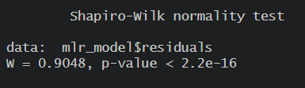
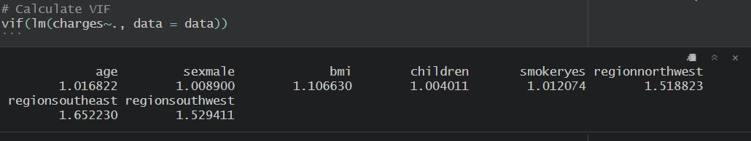
LINE Assumption Continued...
Notes:
D
Based on the Shapiro-Wilk test, the data is not normally distributed. However, due to the fact our dataset is quite large, we can reasonably use the central limit theorem. This is because (n - p) >= 30 where (1338 - 10) >= 30.
Based on the calculation of the VIF, there exists no multicollinearity between any of the predictors.

Slide 12
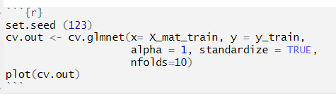
LASSO Regression
Shrinkage Method
Feature Selection
Notes:
e

Slide 13
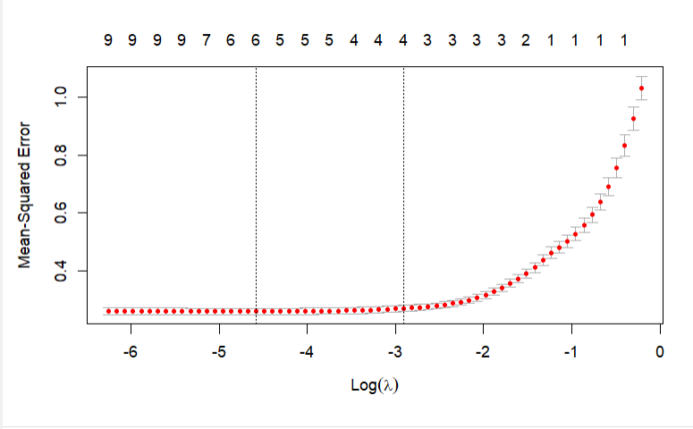
Lambda Versus MSE
Notes:
e

Slide 14
Model Comparison
RMSE of the full model: 5763.38
RMSE of the adjusted model: 5783.39
RMSE of the LASSO Regression Model: 5763.05
Notes:
e

Slide 15
Conclusion
Improvements to the model could be made by using AIC or BIC and forward or backward selection.
Anomalies in LINE assumptions could be improved.
Utilizing an ANOVA table to examine insignificant predictors.
Age, BMI, Children, and Smoking are all significant predictors in insurance charges.
Full model is the best predictor, using results from the Lasso Regression.
Notes:
D
In conclusion, this project demonstrated a completely data analysis pipeline, from data collection to model comparison.

Slide 16
Questions?

